Slide 1
BT 601: Analytical Biotechnology
-Prof. Siddhartha Sankar Ghosh
Lec-1

Slide 2
Lecture 5
IR Spectroscopy

Slide 3
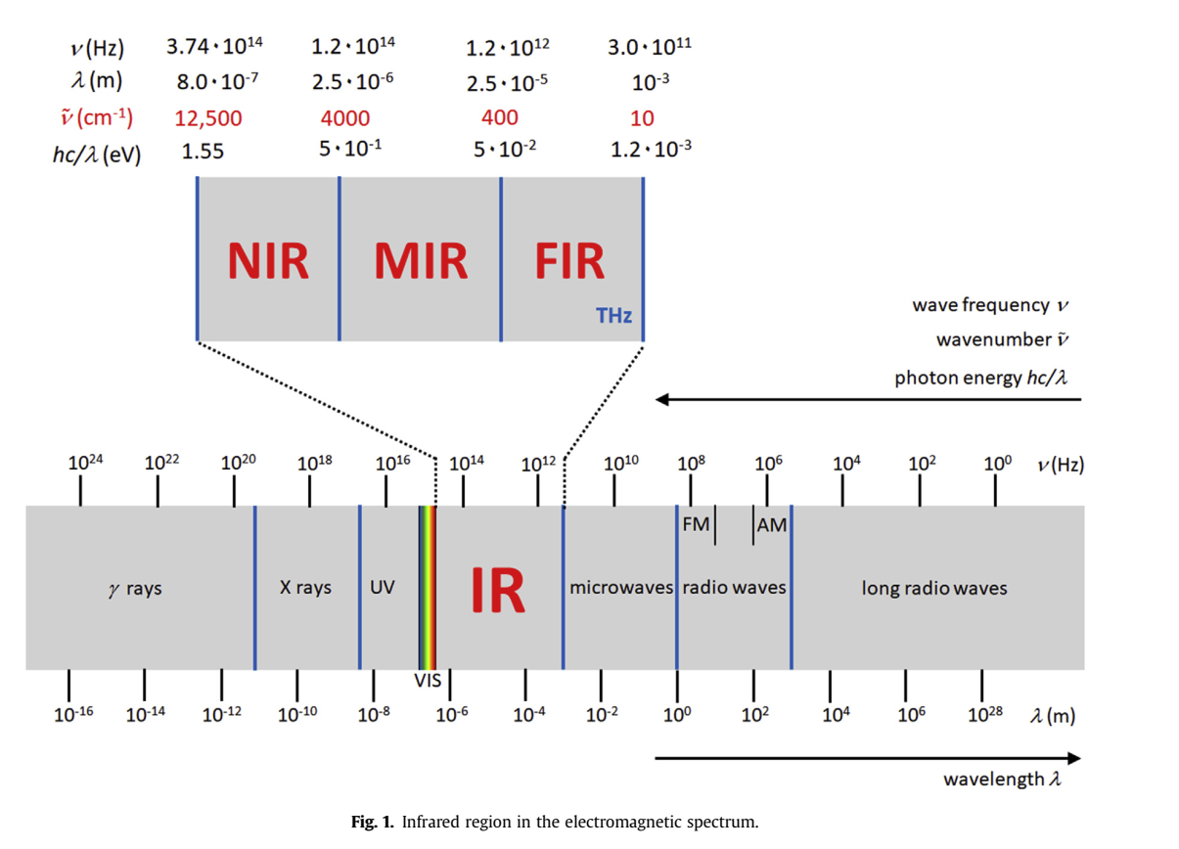

Slide 4
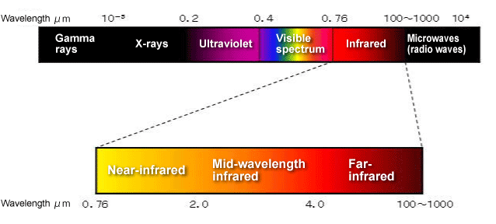
INTRODUCTION
Infrared Spectroscopy or vibrational spectroscopy is concerned with the study of absorption of infrared radiation, which results in vibrational transition.
The infrared region of the spectrum can alter the vibrational and rotational states of covalent bonds in organic molecules.
Various bands will be present in IR spectrum, which will correspond to the characteristic functional group and bonds present in chemical substance.
Thus an IR spectrum of a chemical substance is a fingerprint for its identification
A molecule can be identified by comparing its absorption peak to a data bank of spectra.
The range of Infrared region is 12800 ~ 10 cm⁻¹ and can be divided into near-infrared region (12800 ~ 4000 cm⁻¹), mid-infrared region (4000 ~ 200 cm⁻¹) (most common) and far-infrared region (50 ~ 1000 cm⁻¹).

Slide 5
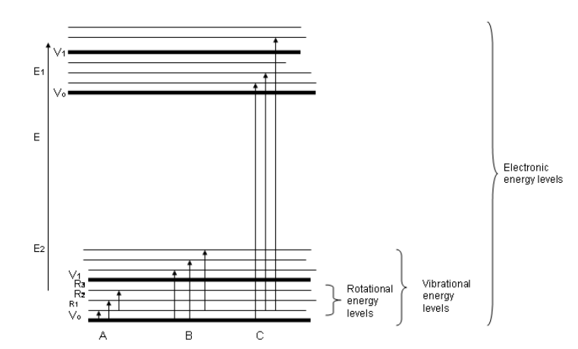
PRINCIPLE
Every inter-atomic bond or portion of a molecule or functional group requires different frequency for absorption.
When frequency of IR radiation is equal to natural frequency of vibration, molecules absorb IR radiation, and a peak is absorbed
The energy levels in IR radiation can be rated in the following order: electronic > vibrational > rotational. Rotational transitions occur at lower energies (longer wavelengths) (this energy is insufficient and cannot cause vibrational and electronic transitions) but vibrational (near infra-red) and electronic transitions require higher energies.
A criterion for IR absorption is a net change in dipole moment in a molecule as it vibrates or rotates. As the molecule vibrates, there is a fluctuation in its dipole moment
Figure: Energy levels for a molecule.
Possible transitions that occur:
(A): Pure rotational Transitions,
(B) Rotational-Vibrational Transitions,
(C) Rotational-Vibrational-Electronic Transitions

Slide 6
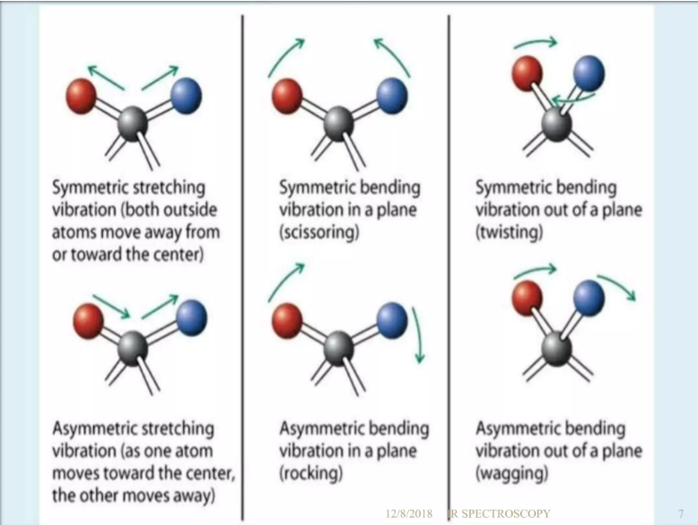
TYPES OF VIBRATIONS
The bond of a molecule experiences various types of vibrations and rotations.
Vibrational motions are defined by stretching and bending modes.
Stretching Vibration: When there is a continuous change in the interatomic distance along the axis of the bond between two atoms, this process is known as a stretching vibration.
Bending Vibration: A change in the angle occurring between two bonds is known as a bending vibration. Four bending vibrations exist namely, wagging, twisting, rocking and scissoring.
Figure: Types of Vibrational Modes

Slide 7

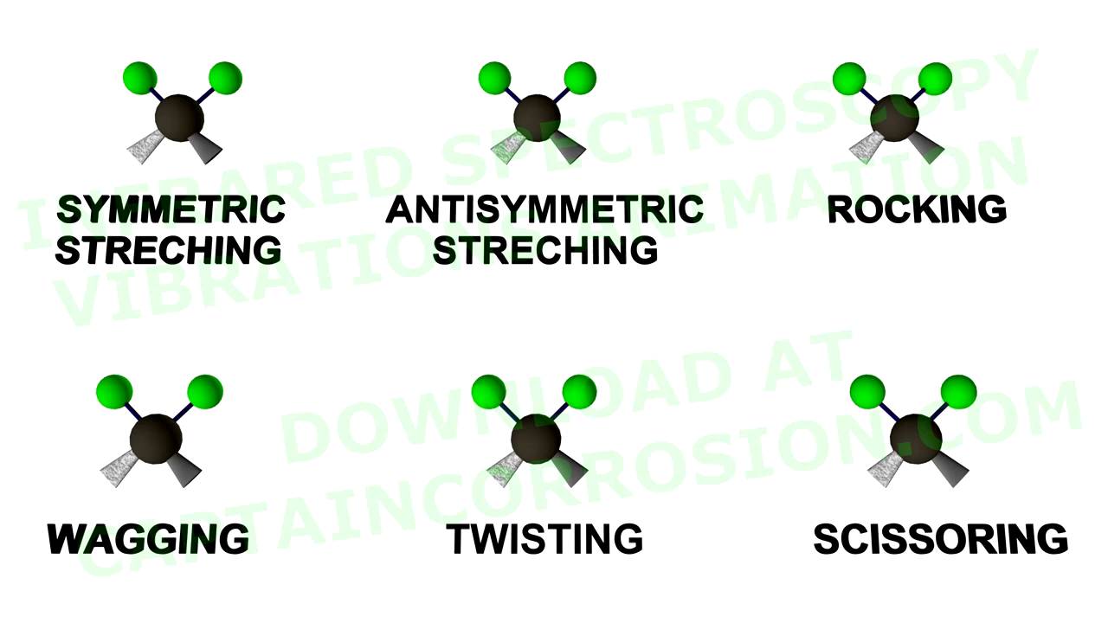
Animation: Types of Vibrational Modes.

Slide 8
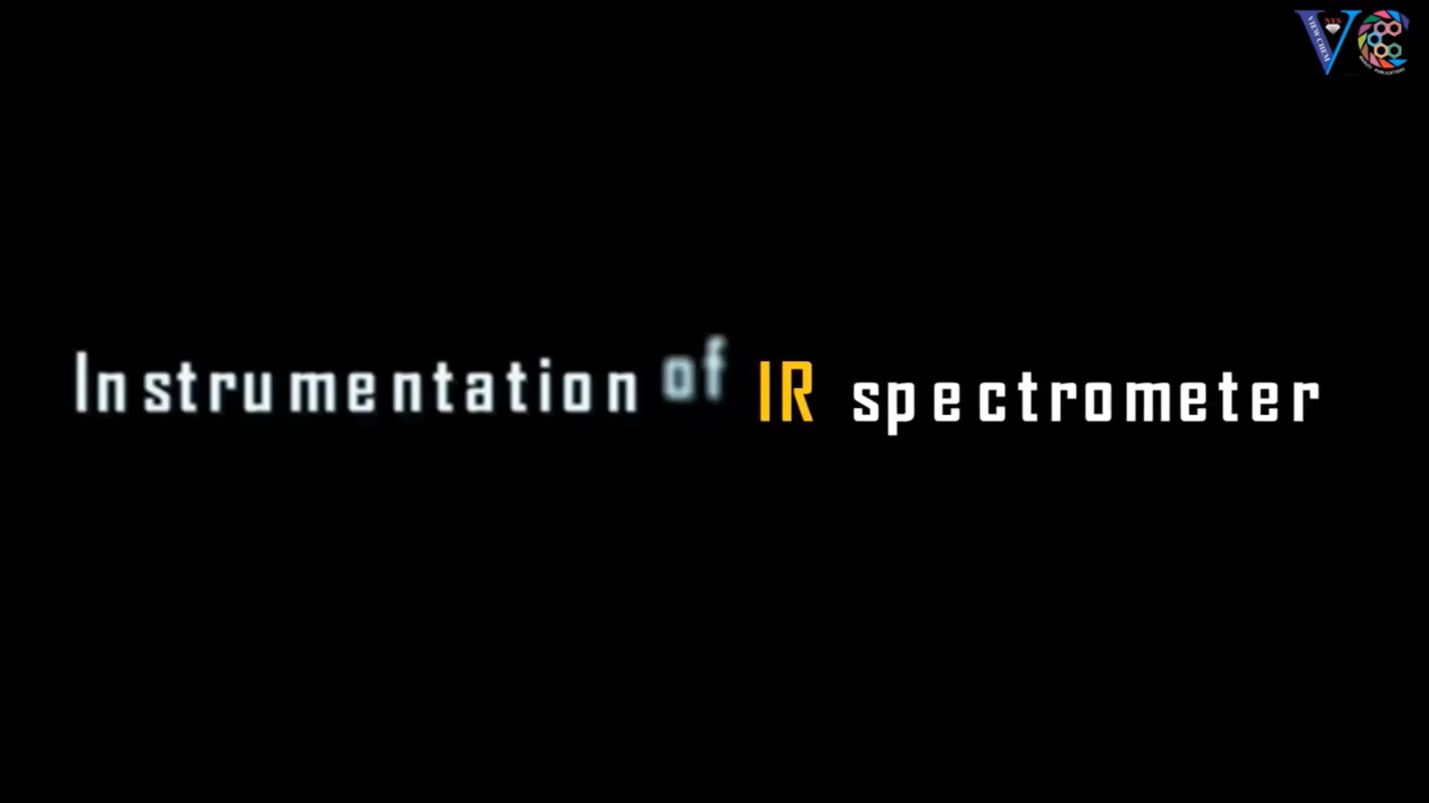
Animation: Principle and Instrument of IR spectrometer

Slide 9
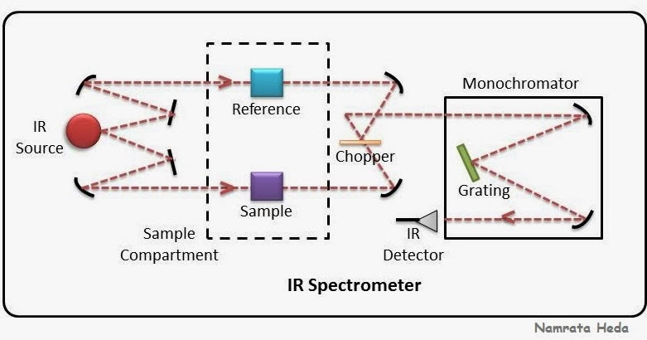
INSTRUMENTATION
The basic components of an IR spectrometer include a radiation source, sample cell, monochromator, and detector.
The common IR radiation sources are inert solids that are heated electrically to promote thermal emission of radiation in the infrared region of the electromagnetic spectrum. (Nernst glower, globar, or laser)
2. The monochromator is a device used to disperse IR radiation into individual narrow IR frequencies.
Generally, dispersive spectrometers have a double-beam design with two equivalent beams from the same source passing through the sample and reference chambers as independent beams.
These reference and sample beams are alternately focused on the detector by making use of an optical chopper, such as, a sector mirror.
One beam will proceed, traveling through the sample, while the other beam will pass through a reference species for analytical comparison of transmitted photon wavefront information.

Slide 10
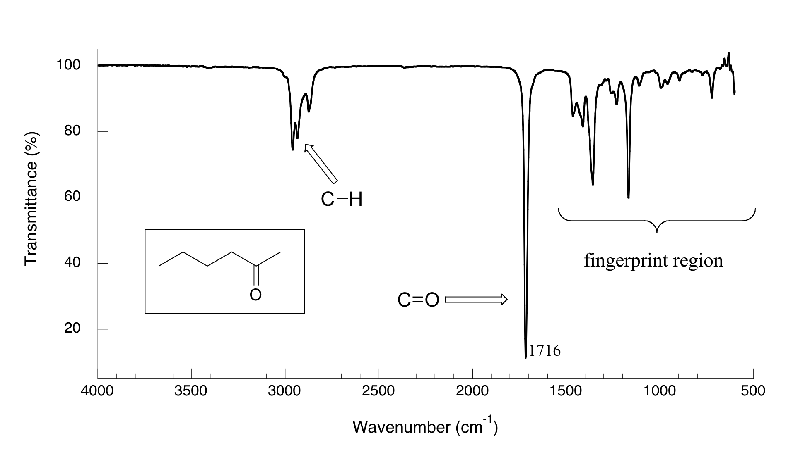
IR spectrum for 2-hexanone

Slide 11
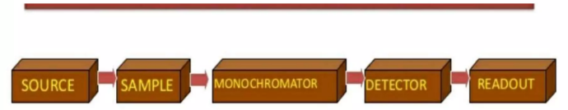
3. After the incident radiation travels through the sample species, the emitted wavefront of radiation is dispersed by a monochromator (gratings and slits) into its component frequencies. A combination of prisms or gratings with variable-slit mechanisms, mirrors, and filters comprise the dispersive system.
4. The emitted wavefront beam (analog spectral output) hits the detector and generates an electrical signal as a response.
Detectors are devices that convert the analog spectral output into an electrical signal. These electrical signals are further processed by the computer using mathematical algorithm to arrive at the final spectrum.
The detectors used in IR spectrometers can be classified as either photon detectors or thermal detectors.

Slide 12
DEVELOPMENT OF IR SPECTROMETERS (GENERATIONS)
The first generation IR spectrometer was invented in late 1950s.
It utilizes prism optical splitting system. The prisms are made of NaCl.
The requirement of the sample’s water content and particle size is extremely strict.
Further more, the scan range is narrow. Additionally, the repeatability is fairly poor. They are no longer in use.
2. The second generation IR spectrometer was introduced to the world in 1960s.
It utilizes gratings as the monochrometer.
The performance of the second generation IR spectrometer is much better with the use of prism monochrometer.
Prominent weaknesses such as low sensitivity, low scan speed and poor wavelength accuracy.
3. The third generation IR spectrometer: Fourier transform infrared spectrometer
Marked the abdication of monochrometer and the prosperity of interferometer.
These IR spectrometers became exceptionally powerful & various applications of IR spectrometer have been realized.

Slide 13
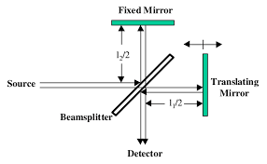
Michelson Interferometer
The Michelson interferometer, which is the core of FTIR spectrometers, is used to split one beam of light into two so that the paths of the two beams are different. Then the Michelson interferometer recombines the two beams and conducts them into the detector where the difference of the intensity of these two beams are measured as a function of the difference of the paths.
Schematic of the Michelson Interferometer.
A typical Michelson interferometer consists of two perpendicular mirrors and a beamsplitter.
One of the mirror is a stationary mirror and another one is a movable mirror.
The beamsplitter is designed to transmit half of the light and reflect half of the light.
Subsequently, the transmitted light and the reflected light strike the stationary mirror and the movable mirror, respectively.
When reflected back by the mirrors, two beams of light recombine with each other at the beamsplitter.

Slide 14
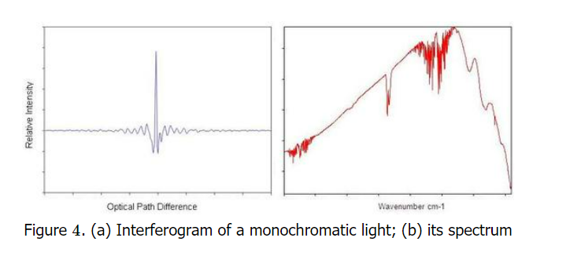
The Fourier Transform
Fourier Transform of Interferogram to Spectrum:
The interferogram is a function of time and the values outputted by this function of time are said to make up the time domain.
The time domain is Fourier transformed to get a frequency domain, which is deconvolved to product a spectrum.
Figure shows the Fast Fourier transform from an interferogram of polychromatic light to its spectrum.
The Fourier Transform
The first one who found that a spectrum and its interferogram are related via a Fourier transform was Lord Rayleigh.
The Fourier Transform is a mathematical method to transform a function into a new function.
The third generation IR spectrometer: Fourier transform infrared spectrometer marked the abdication of monochrometer and used interferometer; offers better resolution and sensitivity

Slide 15
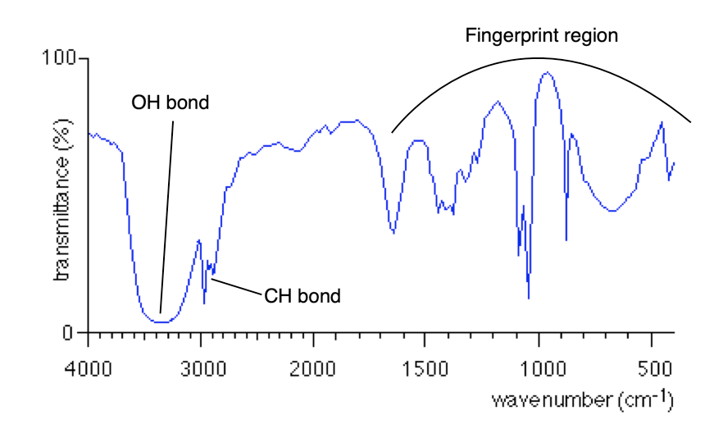
IR SPECTRUM
1. Functional group region: C-H stretching vibrations usually appear between 3200 and 2800cm⁻¹ and carbonyl(C=O) stretching vibrations appear between 1800 and 1600cm⁻¹. This makes these bands diagnostic markers for presence of a functional group in a sample.
2. Fingerprint region: The region of the infrared spectrum from 1200 to 700 cm⁻¹ is called the fingerprint region.
This region is notable for the large number of infrared bands that are found there.
The pattern of absorbance peaks in the fingerprint region is unique to every molecule, meaning that the data from an unknown sample can be compared to the IR spectra of known standards in order to make a positive identification.
Many different vibrations, including C-O, C-C and C-N single bond stretches, C-H bending vibrations, and some bands due to benzene rings are found in this region.
TRANSMISSION vs. ABSORPTION: When a chemical sample is exposed to the action of IR light, it can absorb some frequencies and transmit the rest.
The detector: detects the transmitted frequencies, and by doing so also reveals the values of the absorbed frequencies

Slide 16
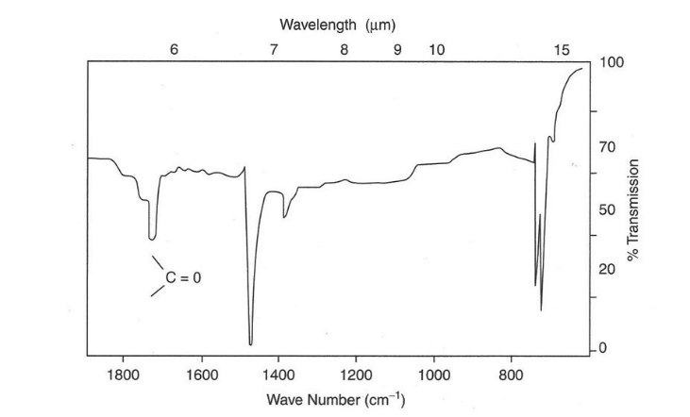
IR SPECTRUM : Example
Here, the IR spectrum of Formaldehyde is taken as an example. Formaldehyde has a C=O functional group and C-H bond.
A molecule with a C=O stretch has an IR band which is usually found near 1700 cm⁻¹ and around 1400 cm⁻¹ for CH₂ bend.
The higher 1700 cm⁻¹ indicates a large dipole moment change. It is easier to bend a molecule than stretch it, hence stretching vibrations have higher frequencies and require higher energies than bending modes.
The finger print region is a region from 1400-650 cm⁻¹. Each molecule has it's own characteristic print.

Slide 17
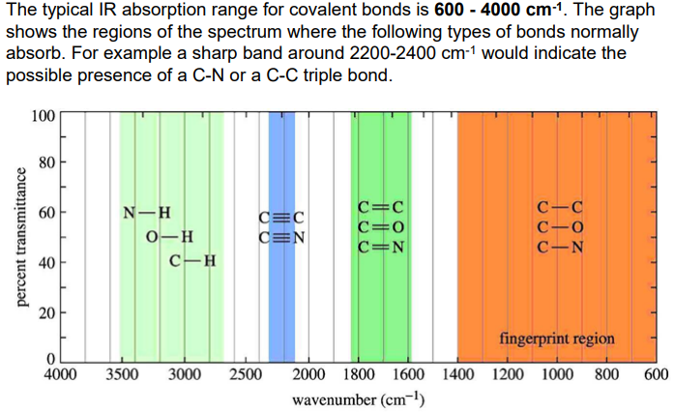
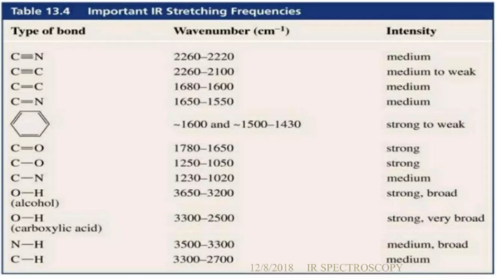
APPLICATIONS
The IR spectrum of an organic compound is a unique physical property and can be used to identify unknowns by interpretation of characteristic absorbances and comparison with spectral libraries.
Provides mostly information about the presence or absence of certain functional groups.
IR spectroscopy is also used in quantitative techniques because of its sensitivity and selectivity. It can be used to quantitate analytes in complex mixtures and is used extensively in detection of industrial pollutants in the environment.
Helps to identify the impurities in a drug sample as impurities have different chemical nature when compared to pure drug and may give rise to additional peaks.

Slide 18
ADVANTAGES OF IR
High Scan Speed: Infrared spectroscopy can get information for the whole range of frequency simultaneously, within one second.
Therefore, IR can be used to analyze a substance that is not very stable and finish the scan before it start to decompose.
High Resolution: The resolution of general prism spectrometer is only about 3 cm⁻¹, but the resolution of infrared spectrometer is much higher.
For example, the resolution of Grating infrared spectrometer could be 0.2 cm⁻¹, the resolution of FT infrared spectrometer could be 0.1-0.005 cm⁻¹.
High Sensitivity: With Fourier Transform, the reflection will be increased and the loss of energy in the analysis process will be decreased. Therefore the energy that reaches the detector is large enough and even very small amount of analytes could be detected.
Nowadays, the infrared spectroscopy could detect the sample as small as 1-10 grams.
Wide Range of Application: Infrared spectroscopy could be used to analyze almost all organic compounds and some inorganic compounds. Also, the sample of Infrared spectroscopy doesn't have phase constraints. It could be gas, liquid or solid, which has enlarged the range of analytes a lot.
Large Amount of Information: Infrared Spectra could give us lots of structural information of the analytes, such as the type of compound, the functional group of compound, the stereoscopic structure of compound, the number and position of substituent group. Depending on the available information form functional part and fingerprint part, infrared spectroscopy has become a great method to identify different kinds of compounds.
Non-Destructive: Infrared Spectroscopy is non-destructive to the sample.

Slide 19
DISADVANTAGES OF IR
Sample Constraint: Infrared spectroscopy is not applicable to the sample that contains water since this solvent strongly absorb IR light.
Spectrum Complication: the interpretation of IR spectrum depends on lots of experience. Sometimes, we cannot definitely clarify the structure of the compound just based on one single IR spectrum. Other spectroscopy methods, such as ( Mass Spectrometry) MS and ( Nuclear Magnetic Resonance) NMR, are still needed to interpret the specific structure further.
Quantification: Infrared spectroscopy works well for the qualitative analysis of a large variety of samples, but quantitative analysis may be limited under certain conditions such as very high and low concentrations.

Slide 21
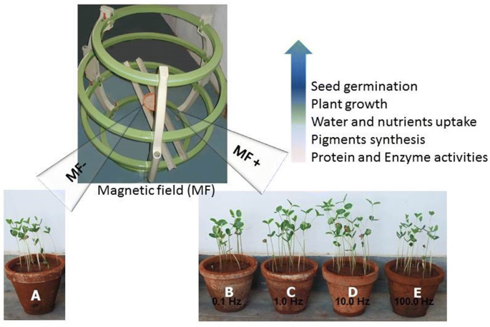

Slide 22
Essential Points
Magnetic field treatment of seeds became very popular in the agricultural sector.
Pre-sowing seed treatment with SMF, called “magnetopriming”, is a non-destructive method.
Dry seed priming treatment that has been reported to increase the rate of germination and seedling vigor of many crops.

Slide 23
Summary of work
Magnetic field treatments have been utilized to promote germination and growth of a variety of species of plants
Wheat seedlings were treated with 500mT and 1500mT static magnetic field (SMF) for 10 and 20 min, respectively.
Analyzing Fourier transform infrared spectra collected from leaves of seedlings showed that SMF treatments decreased the contents of lipids and proteins, shifted bands to higher wavenumbers in 3000– 2800 cm⁻¹ regions, and increased the ratio of CH2/CH3 which likely indicates a structural variation of lipids.
For bands assigned to different second structures of proteins, slight bands shifting and changing the ratio of different second structures of proteins were observed due to SMF treatments.
The results revealed that lipids rather than proteins were sensitive to SMF treatments.
The results provided insight into the SMF induced conformational changes of lipids and proteins in wheat leaves, which will help elucidate the biological mechanisms of SMF on plant growth and development.

Slide 25
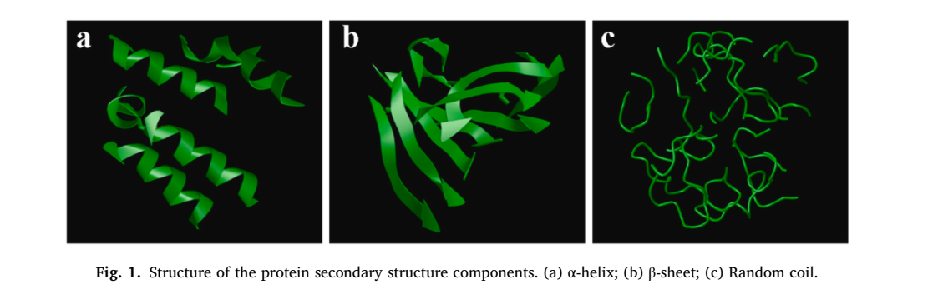

Slide 29
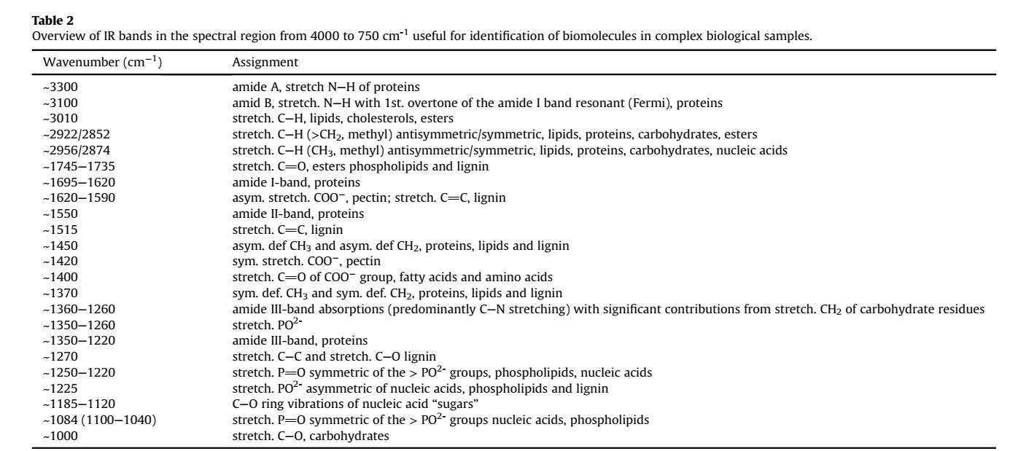

Slide 30
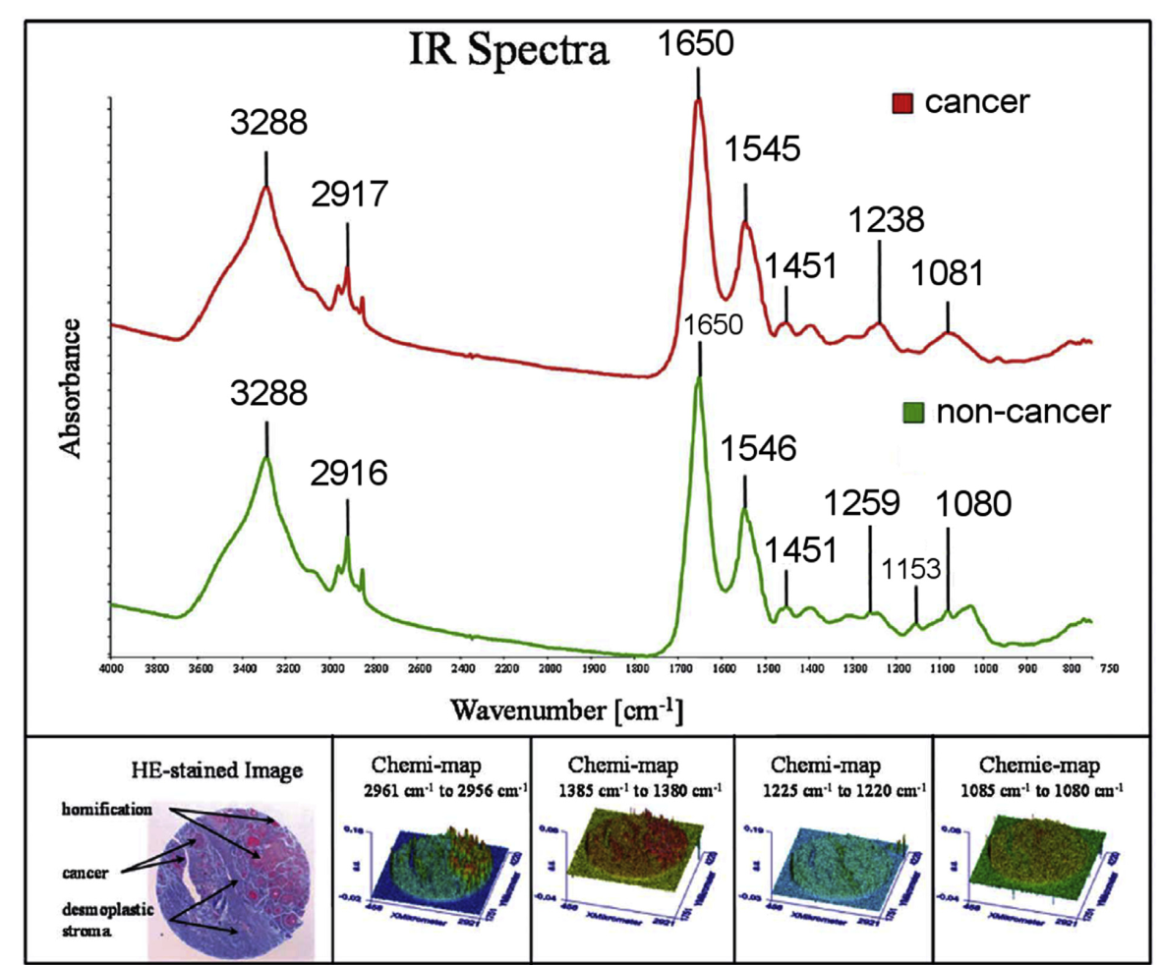
Comparison of non-cancerous (green) and cancerous (red) overall average spectra obtained from a tissue after 4 h dewaxing with octane, displayed in the range from 4000 cm1 to 750 cm1. Major absorption bands are indicated. Additionally, the Hematoxylin and eosin stained (HE-stained) tissue section with the corresponding chemi-map representation is displayed.

Slide 31
THANK YOU

